Slide 1
Sprint 1 Status Update (Mid-sprint Submission 1)
Team Name:- Nexus Proposal
Calss Date:- 03/02/2025

Slide 2
team Members
Robert Jay Dunlap Scrum Master
Nithiya Varsha Markandan Rajendren Developer
Sai Ashish Redd Shetpally Developer
Soumith Alloju Product Owner
Romin Katre Developer
Zijie He Developer

Slide 3
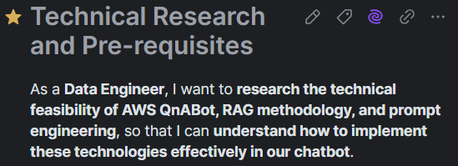
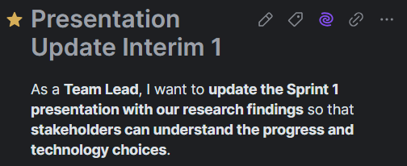
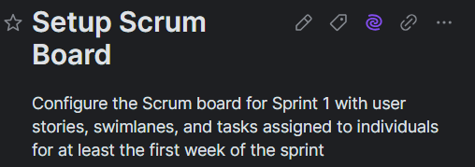
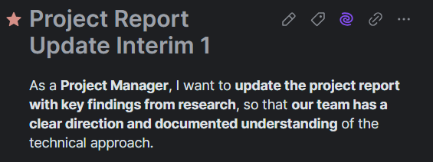
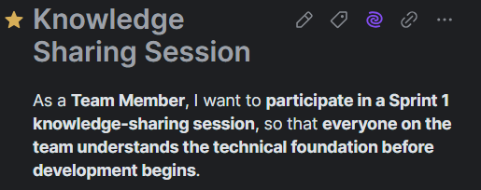
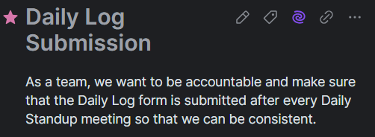
YouTrack
Here is a quick summary of all the User Stories we have made and the tasks status

Slide 4

problem statement
Problem Context:
Domain of problem: The problem falls within the domain of corporate proposal writing, specifically in industries such as government contracting, consulting, finance, and enterprise business development. These sectors require frequent proposal submissions to secure contracts, grants, or client agreements.
Importance of problem: Inefficient proposal management leads to delays, inconsistencies, and increased workload for proposal writers, reducing the organization's ability to respond to opportunities swiftly. Manually searching for past performance data, case studies, and compliance information consumes valuable time and increases the risk of missing critical details, ultimately impacting business growth and competitive positioning.
Problem Statement: Proposal writers struggle to retrieve past performance data, case studies, and compliance details efficiently, leading to delays and inconsistencies. Manual searches waste time, increasing workload and the risk of missing critical information. An AI-powered retrieval assistant is needed to streamline access to relevant data, improving efficiency, consistency, and proposal quality.

Slide 5

Datasets
Proposed Datasets for Project [for each dataset]
Dataset Name: Allwyn Case Study & Proposal Archive
Dataset Owner: Allwyn Corp.
Dataset Type: proprietary(Document Based)
Dataset Size: 5GB approx.
Source: AI Generated

Slide 6
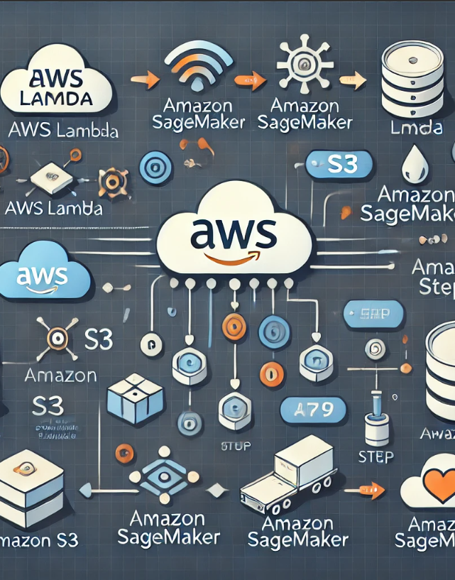
Potential Analytics/algorithms
Analytic/Algorithm Name: Retrieval-Augmented Generation (RAG) with AWS Kendra and Bedrock for AI-Assisted Proposal Retrieval
Datasets:
Past Performance Database (SharePoint) – Records of previous project work.
Historical Proposal Documents – Previous proposals for reference and template structuring.
Case Study Repository – Success stories and project summaries.
Computer Resources Required:
Cloud Resources: AWS Services (Lex, Lambda, Kendra, OpenSearch, DynamoDB, Bedrock, SageMaker).
For Model Inference: AWS Bedrock (GenAI Inference) and AWS Lambda (Serverless Execution).
For RAG Search & Indexing: Amazon Kendra & OpenSearch.
Training: AWS Kendra indexing will require an initial setup phase to train on relevant knowledge bases (past proposals, case studies).
Optimization:
Query Optimization: Fine-tuning AWS Kendra search ranking for highly relevant retrievals.
Prompt Engineering: Improving Bedrock’s Anthropic Claude prompt structure for more contextually appropriate responses.
Testing:
Query Testing: Run sample queries to check retrieval quality.
Test real-world proposal writing use cases.
Assess Bedrock model response quality in structured retrieval scenarios.
Source: AI Generated

Slide 7
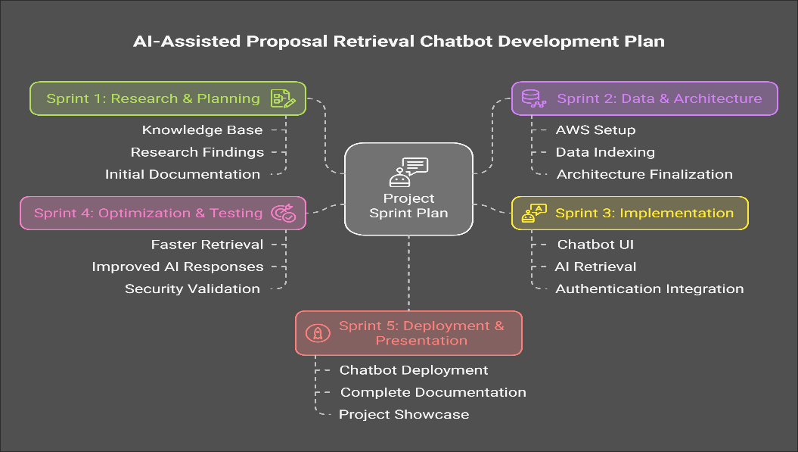
Project Schedule
Source: AI Generated

Slide 8
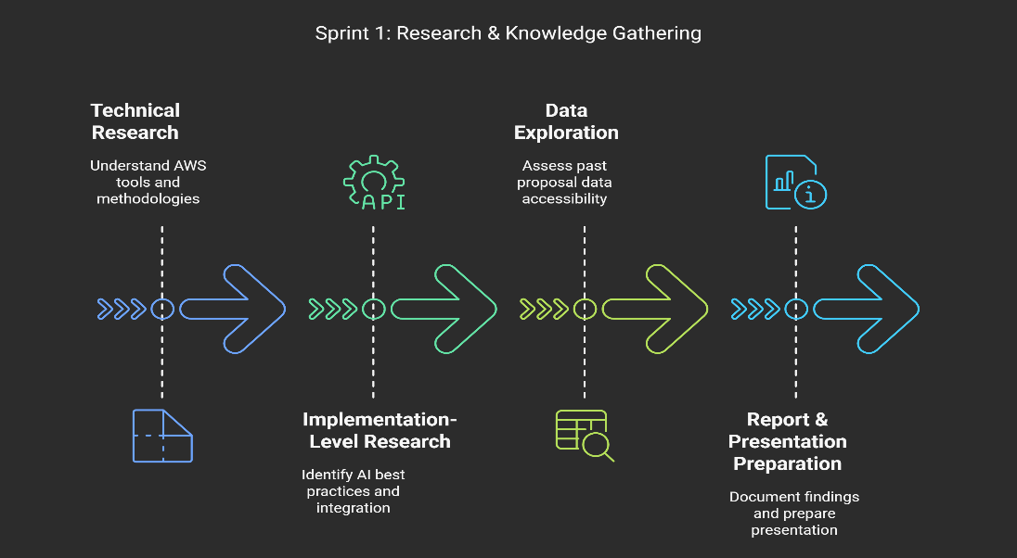
SPRINT 1 Schedule
Source: AI Generated

Slide 9
Risks and Planned Mitigations
Risk Name | Description | Probability | Impact | Mitigation
Access to Allwyn test files | Gaining access in time to the sample set of documents in Allwyn’s Sharepoint Repository to allow us to do the planned work in this sprint. We can’t move forward without access to the SharePoint and files. | Low | High | We will communicate with Allwyn’s CTO and Intern to work through gaining access and will keep our professor informed. Our professor will be able to work with Allwyn to resolve the issue or change our overall project objective if necessary.
Access to AWS services account | Kendra and Bedrock are expected to be important elements of our technical solution. If we can’t gain access this sprint we will not be in position to start doing work with them in the next spring and this will delay our progress. | Low | High | We will communicate with our Professor to understand where we are along the path to gaining access and he will be able to help us resolve access issue.
Connecting Kendra to Allwyn’s SharePoint | None of us have worked with these systems before and we may not be successful in learning how to make them work. | Medium | High | We will aggressively pursue learning from available web sources and will communicate with our professor if we’re blocked. He will be able to get technical support from AWS to help us resolve real blockers.
Organizing the team to work effectively | We are all new to Scrum and the Product Owner and Scrum Master are inexperienced in these roles | High | Low | The project is small enough that we could fall back to less organized methods and still be successful, however we want to use the system and will have internal team training sessions to normalize expected behavior and activities. We will also find more training resources if necessary.

Slide 10

Weekly Partner Meeting
Partner name: Allwyn Corp.
Team Progress from Prior Week
Conducted background research on proposal automation and AI-based retrieval.
Performed technical research to evaluate new approaches to enhancing the solution.
Team Tasks for Current Week
Continue research on AWS-based solutions and explore local development options (pending partner approval).
Begin data exploration once access is granted by the partner.
Other Items Discussed
Explored new methodologies for developing the RAG model, including local development alternatives.
Discussed the potential use of Graph-Based RAG for improved retrieval and knowledge structuring.
Source: Webpage

